Slide 1
DevOps for Beginners

Slide 2
Topic of this Course 1-http/https,Nginx 2-Docker 3-Git/Gitlab CI 4-Bash scripting 5-Ansible 5-Prometheus/Grafana

Slide 3

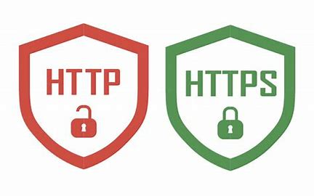
HTTP/HTTPS
HTTP, or Hypertext Transfer Protocol, is the foundation of data communication on the World Wide Web. It is an application-layer protocol used for transmitting hypermedia documents, such as HTML, between clients
HTML: How could help to HTTP
1.Formating Data
2.Linking between files
3.Font Style

Slide 4
HTTP/HTTPS
How HTTP Works
Client-Server Model:
A client (e.g., a web browser) sends an HTTP request to a server.
The server processes the request and sends back an HTTP response.
Stateless Protocol:
HTTP is stateless, meaning each request is independent and unrelated to previous requests. Sessions or state management (e.g., cookies) are handled at the application level.

Slide 5
HTTP/HTTPS
Request Methods:
Common HTTP methods include:
GET: Retrieve data from the server(Fetching a user's profile).
POST: Send data to the server for processing(for example login,create user).payload boy of request
PUT: Store specified data or update existing data on the sepecified location on server(upload image).
DELETE: Remove data from the server(delete user account).
PATCH: Partially update data on the server(Changing a user's email address)
HEAD: request the title of the request
OPTION:Retreive the HTTP request s that the server support

Slide 6
HTTP/HTTPS
Versions of HTTP
HTTP/1.0: Basic version with limited features.
HTTP/1.1: Improved performance with persistent connections and chunked transfer encoding.
HTTP/2: Introduced multiplexing, header compression, and server push for faster performance.
HTTP/3: Uses QUIC (a transport protocol over UDP) for reduced latency and improved reliability.

Slide 7

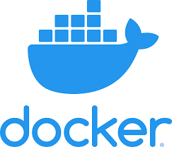
Docker
Docker is an open platform for developing, shipping, and running applications. Docker enables you to separate your applications from your infrastructure so you can deliver software quickly.
Baremetal vs Vm and efficiency docker in bare 5X .

Slide 8
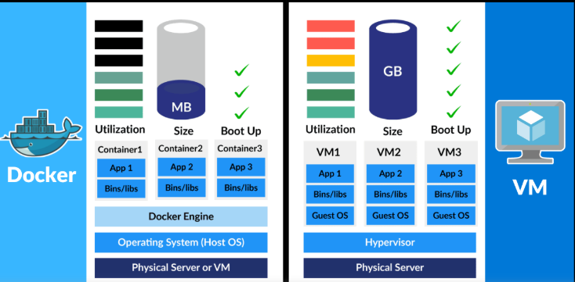
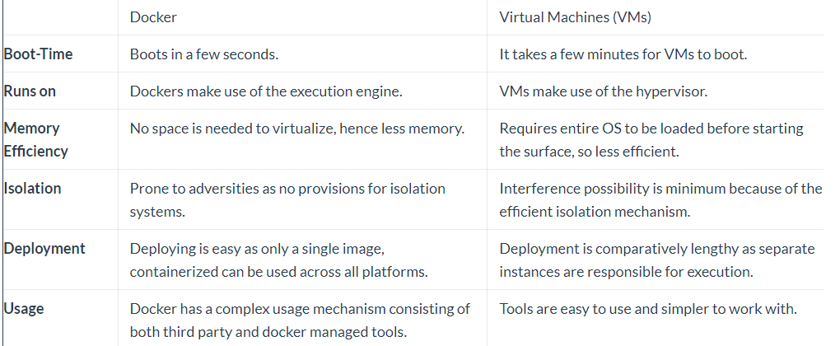
vm vs container

Slide 9

what is image?
A Docker image is a collection of all the files that make up and executable software app.
This collection includes the all the lib,bin,modules and dependency just need to run the app everywhere.
Image is read only

Slide 10
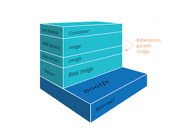
Image architechure
Layer :
1-Layers consist of parent child relation just first layer 2-don’t have parent said base image
3-Docker image use shared kernel of docker host
4-Layers are Reusable and Shared
5-Rebuilding the image will be faster

Slide 11

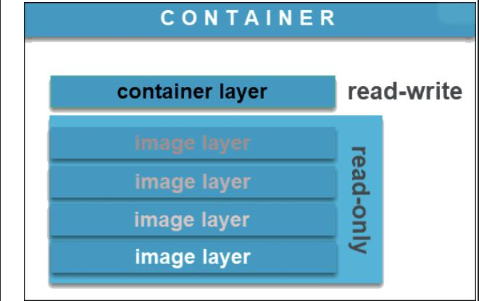
what is container
A Docker container image is a lightweight, standalone, executable package of software that includes everything needed to run an application: code, runtime, system tools, system libraries and settings
Container is writable.
Image vs container

Slide 12

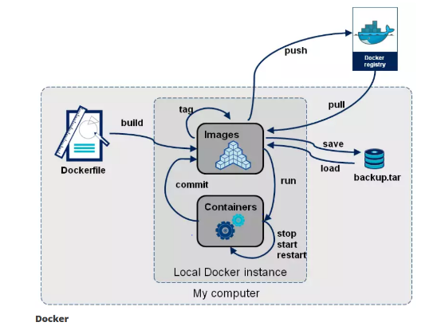
Docker Registry
A Docker Registry is a play that docker images store in it.
Docker Registry consist of public or private
Public DockerHub
Private Harbor or Nexus repo

Slide 13
Installation docker
on linux https://docs.docker.com/engine/install/
on windows
https://docs.docker.com/desktop/install/windows-install/

Slide 14
Docker Concept
docker version:
Show client version
Show client apiversion
Show server version
Show server api version
Docker written by golang
/var/lib/docker all of docker elements in there
docker info:This command displays system wide information regarding the Docker installation. Information displayed includes the kernel version, number of containers and images. The number of images shown is the number of unique images. The same image tagged under different names is counted only once.

Slide 15
manage docker
The Docker daemon binds to a unix socket instead of a tcp port.by default unix socket is owned by root .docker daemon always runs as the root user!
Docker Daemon: A persistent background process that manages
Docker images, containers, networks, and storage volumes.
Non root use below manual
groupadd docker
usermod –aG docker $USER

Slide 16

some Benefit of Docker container
1-Speed
2-Portability
3-Rapid Deployment
4-Run your app in isolation and independent env

Slide 17

solve some problem by container
1-Dependencies
2-Protecting your pc
3-Easy deploy without huge knowledge about program language
4-Security and virus jail

Slide 18


Thanks!
Do you have any questions? addyouremail@freepik.com
+91 620 421 838
yourcompany.com

